Slide 1

Algebra 1
Unit 13, Lesson H2 Combining Functions Volume 2, pg. 297

Slide 2


Benchmark
MA.912.F.3.1
Given a mathematical or real-world context, combine two functions, limited to linear and quadratic, using arithmetic operations. When appropriate, include domain restrictions for the new function.
volume 2, pg. 297

Slide 3
Integrated Mathematical Thinking and Reasoning Standards
MA.K12.MTR.1.1 Actively participate in effortful learning both individually and collectively.
MA.K12.MTR.2.1 Demonstrate understanding by representing problems in multiple ways.
MA.K12.MTR.3.1 Complete tasks with mathematical fluency.
MA.K12.MTR.4.1 Engage in discussions that reflect on the mathematical thinking of self and others.
MA.K12.MTR.5.1 Use patterns and structure to help understand and connect mathematical concepts.
MA.K12.MTR.6.1 Assess the reasonableness of solutions.
MA.K12.MTR.7.1 Apply mathematics to real-world contexts.
volume 2, pg. 297

Slide 4

Learning Targets
I can combine two functions using arithmetic operations.
I can determine domain restrictions for a real-world context where two functions are combined.
volume 2, pg. 297

Slide 5

Warm-Up
volume 2, pg. 298

Slide 6
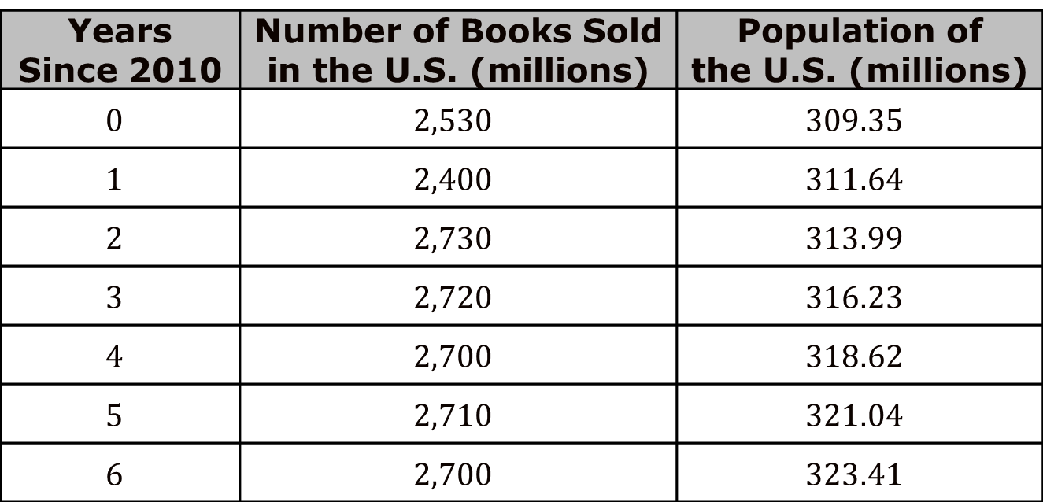
13.H2.1 Warm-Up: Book Sales
The number of books sold, in millions, in the U.S. and the population of the U.S., in millions, from 2010 to 2016 are shown in the table.
Years Since 2010 | Number of Books Sold in the U.S. (millions) | Population of the U.S. (millions)
$$0$$ | $$2,530$$ | $$309.35$$
$$1$$ | $$2,400$$ | $$311.64$$
$$2$$ | $$2,730$$ | $$313.99$$
$$3$$ | $$2,720$$ | $$316.23$$
$$4$$ | $$2,700$$ | $$318.62$$
$$5$$ | $$2,710$$ | $$321.04$$
$$6$$ | $$2,700$$ | $$323.41$$
volume 2, pg. 298

Slide 7
What do you notice?
How many books were sold per person in 2010 and 2016?
What do these values tell you about book sales?
volume 2, pg. 298

Slide 8

Collaboration
volume 2, pg. 298

Slide 9

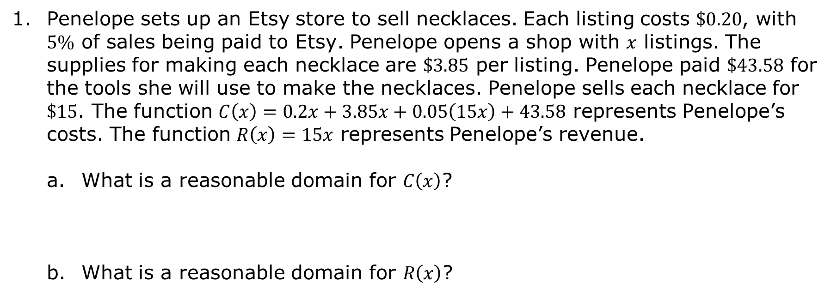
13.H2.2 Collaboration: Real-World Functions
Penelope sets up an Etsy store to sell necklaces. Each listing costs $\$0.20$, with $5\%$ of sales being paid to Etsy. Penelope opens a shop with $x$ listings. The supplies for making each necklace are $\$3.85$ per listing. Penelope paid $\$43.58$ for the tools she will use to make the necklaces. Penelope sells each necklace for $\$15$. The function $C\left(x\right)=0.2x+3.85x+0.05\left(15x\right)+43.58$ represents Penelope’s costs. The function $R\left(x\right)=15x$ represents Penelope’s revenue.
What is a reasonable domain for $C\left(x\right)$?
What is a reasonable domain for $R\left(x\right)$?
volume 2, pg. 298

Slide 10
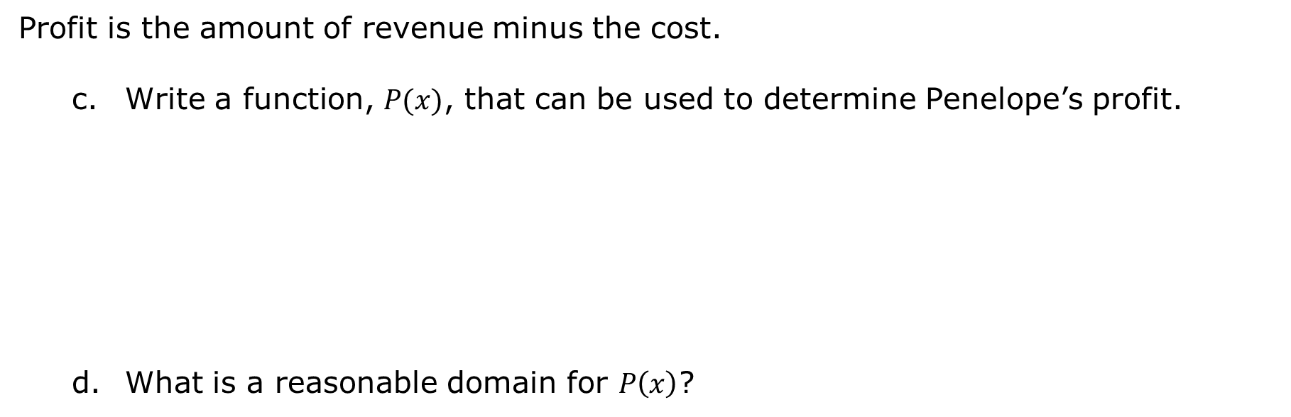
Profit is the amount of revenue minus the cost.
Write a function, $P(x)$, that can be used to determine Penelope’s profit.
What is a reasonable domain for $P\left(x\right)$?
volume 2, pg. 298

Slide 11
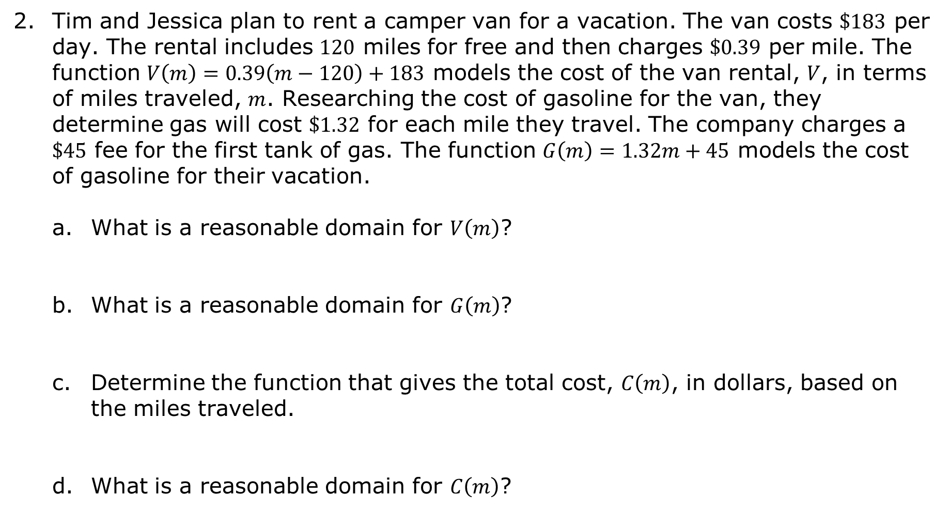
Tim and Jessica plan to rent a camper van for a vacation. The van costs $\$183$ per day. The rental includes $120$ miles for free and then charges $\$0.39$ per mile. The function $V\left(m\right)=0.39\left(m−120\right)+183$ models the cost of the van rental, $V$, in terms of miles traveled, $m$. Researching the cost of gasoline for the van, they determine gas will cost $\$1.32$ for each mile they travel. The company charges a $\$45$ fee for the first tank of gas. The function $G\left(m\right)=1.32m+45$ models the cost of gasoline for their vacation.
What is a reasonable domain for $V\left(m\right)$?
What is a reasonable domain for $G\left(m\right)$?
Determine the function that gives the total cost, $C\left(m\right)$, in dollars, based on the miles traveled.
What is a reasonable domain for $C\left(m\right)$?
volume 2, pg. 299

Slide 12
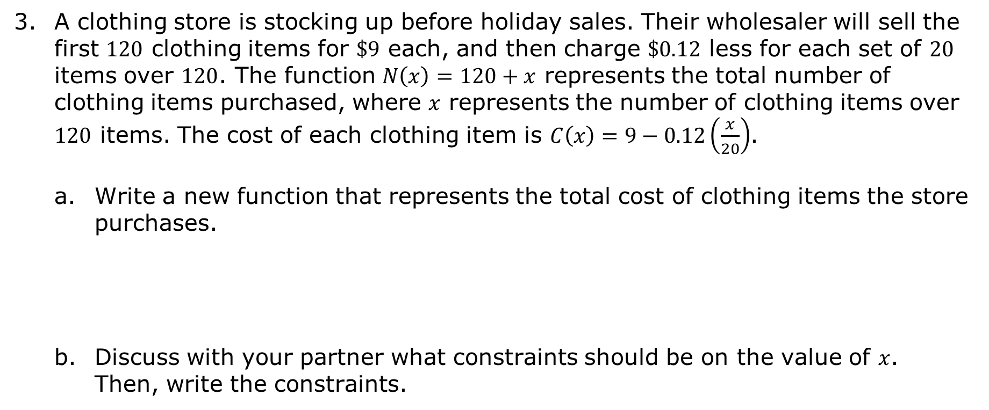
A clothing store is stocking up before holiday sales. Their wholesaler will sell the first $120$ clothing items for $\$9$ each, and then charge $\$0.12$ less for each set of $20$ items over $120$. The function $N\left(x\right)=120+x$ represents the total number of clothing items purchased, where $x$ represents the number of clothing items over $120$ items. The cost of each clothing item is $C\left(x\right)=9−0.12\left(\frac{x}{20}\right)$.
Write a new function that represents the total cost of clothing items the store purchases.
Discuss with your partner what constraints should be on the value of $x$. Then, write the constraints.
volume 2, pg. 299

Slide 13
Ask two classmates the constraints they determined. Record their constraints and write your summary of their reason. You are the only person who should write in the first two columns of the table. Have your classmate initial next to your summary stating that your summary was correct.
Discuss with your partner the constraints given by your classmates. If necessary, revise the constraints you wrote.
Constraint | My Summary of Their Reason | Initials
volume 2, pg. 299

Slide 14

Exploration
volume 2, pg. 300

Slide 15

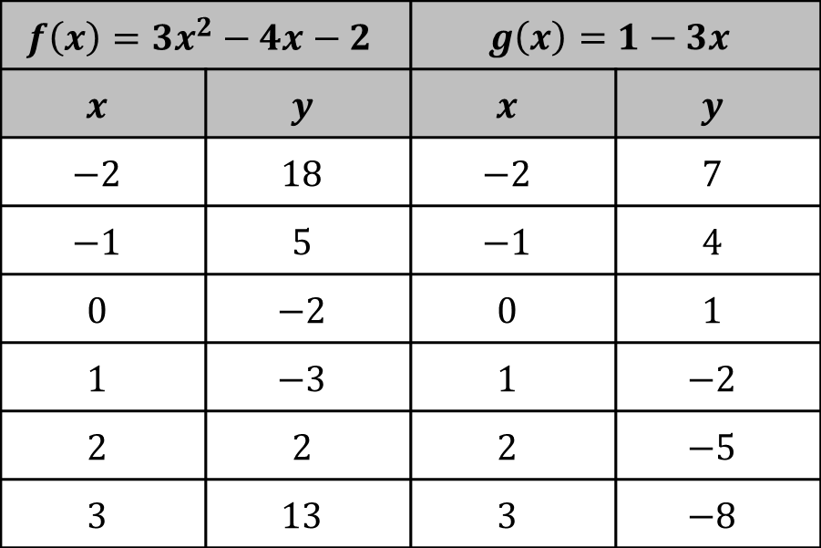
13.H2.3 Exploration: Combining Functions
Tables of values for the functions $f\left(x\right)=3x^{2}−4x−2$ and $g\left(x\right)=1−3x$ are shown.
$$f\left(x\right)=3x^{2}−4x−2$$ |  | $$g\left(x\right)=1−3x$$
$$x$$ | $$y$$ | $$x$$ | $$y$$
$$−2$$ | $$18$$ | $$−2$$ | $$7$$
$$−1$$ | $$5$$ | $$−1$$ | $$4$$
$$0$$ | $$−2$$ | $$0$$ | $$1$$
$$1$$ | $$−3$$ | $$1$$ | $$−2$$
$$2$$ | $$2$$ | $$2$$ | $$−5$$
$$3$$ | $$13$$ | $$3$$ | $$−8$$
volume 2, pg. 300

Slide 16

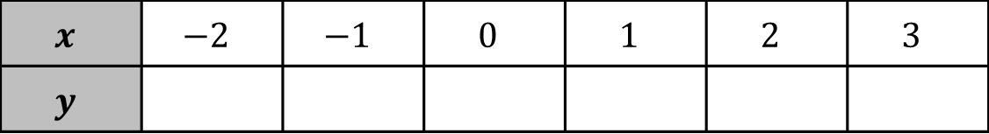
Complete the table for $y=3x^{2}−4x−2+1−3x$.
What strategy did you use to complete the table?
Find $f\left(x\right)+g(x)$. Write your answer in standard form.
$$x$$ | $$−2$$ | $$−1$$ | $$0$$ | $$1$$ | $$2$$ | $$3$$
$$y$$
volume 2, pg. 300

Slide 17
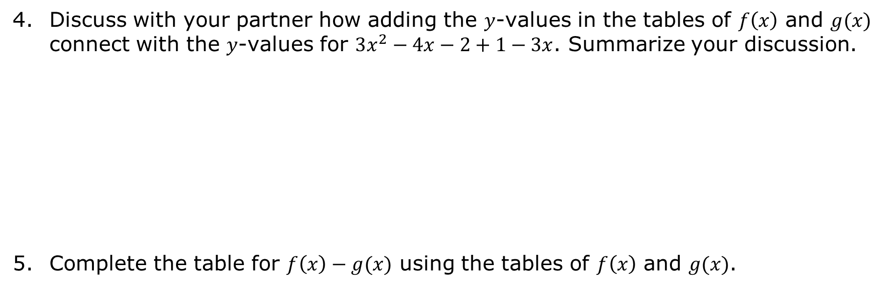
Discuss with your partner how adding the $y$-values in the tables of $f\left(x\right)$ and $g(x)$ connect with the $y$-values for $3x^{2}−4x−2+1−3x$. Summarize your discussion.
Complete the table for $f\left(x\right)−g(x)$ using the tables of $f\left(x\right)$ and $g(x)$.
$$x$$ | $$−2$$ | $$−1$$ | $$0$$ | $$1$$ | $$2$$ | $$3$$
$$y$$
volume 2, pg. 300

Slide 18
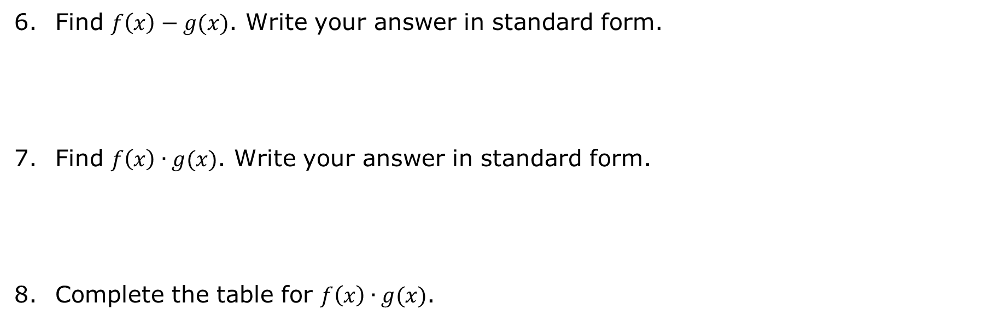
Find $f\left(x\right)−g(x)$. Write your answer in standard form.
Find $f\left(x\right)∙g(x)$. Write your answer in standard form.
Complete the table for $f\left(x\right)∙g(x)$.
$$x$$ | $$−2$$ | $$−1$$ | $$0$$ | $$1$$ | $$2$$ | $$3$$
$$y$$
volume 2, pg. 300

Slide 19

Find $\frac{f\left(x\right)}{g(x)}$.
What value of $x$ will result in a denominator of $0$?
Discuss with your partner why the denominator cannot equal $0$. Summarize your discussion.
volume 2, pg. 301

Slide 20

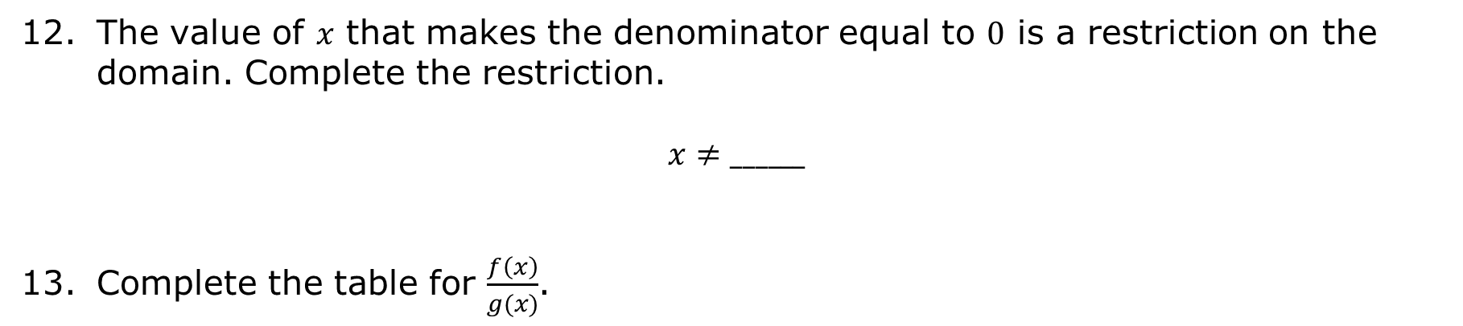
The value of $x$ that makes the denominator equal to $0$ is a restriction on the domain. Complete the restriction.
$$x≠______$$
Complete the table for $\frac{f\left(x\right)}{g(x)}$.
$$x$$ | $$−2$$ | $$−1$$ | $$0$$ | $$1$$ | $$2$$ | $$3$$
$$y$$
volume 2, pg. 301

Slide 21

Bring It Together
volume 2, pg. 301

Slide 22

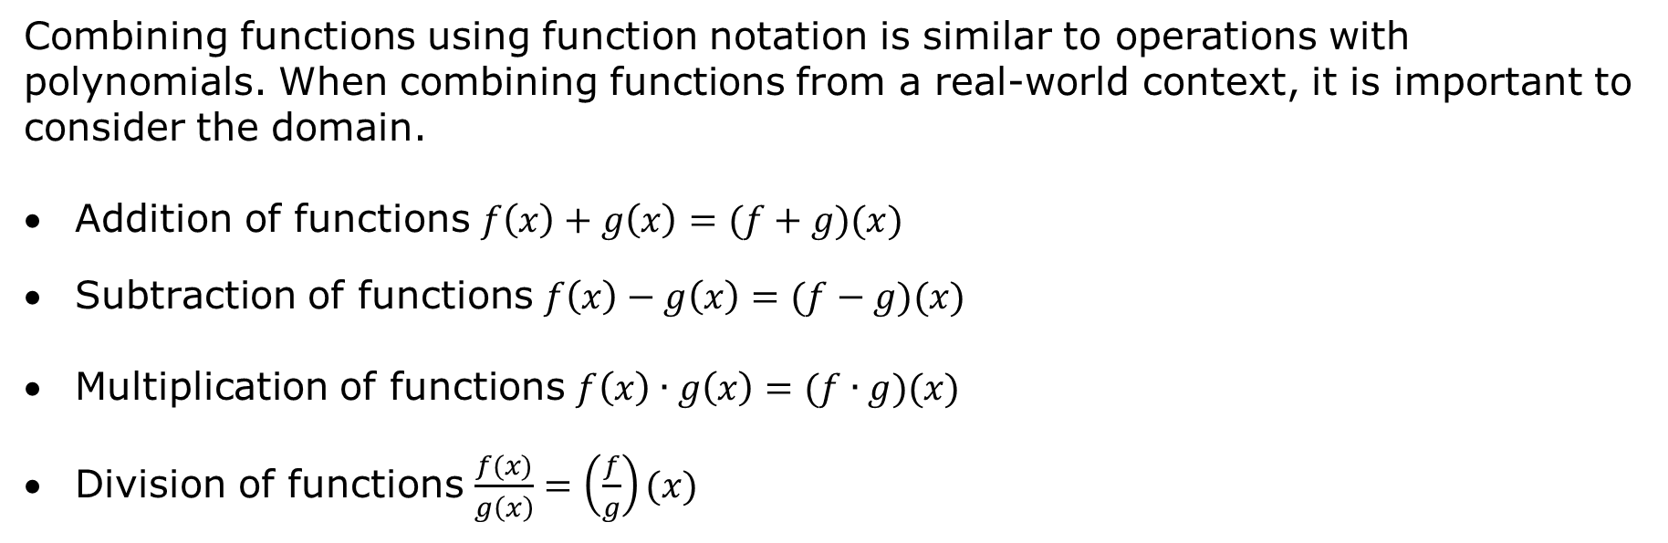
13.H2.4 Bring It Together: Function Operations
Combining functions using function notation is similar to operations with polynomials. When combining functions from a real-world context, it is important to consider the domain.
Addition of functions $f\left(x\right)+g\left(x\right)=(f+g)(x)$
Subtraction of functions $f\left(x\right)−g\left(x\right)=(f−g)(x)$
Multiplication of functions $f\left(x\right)∙g\left(x\right)=(f∙g)(x)$
Division of functions $\frac{f(x)}{g\left(x\right)}=\left(\frac{f}{g}\right)(x)$
volume 2, pg. 301

Slide 23
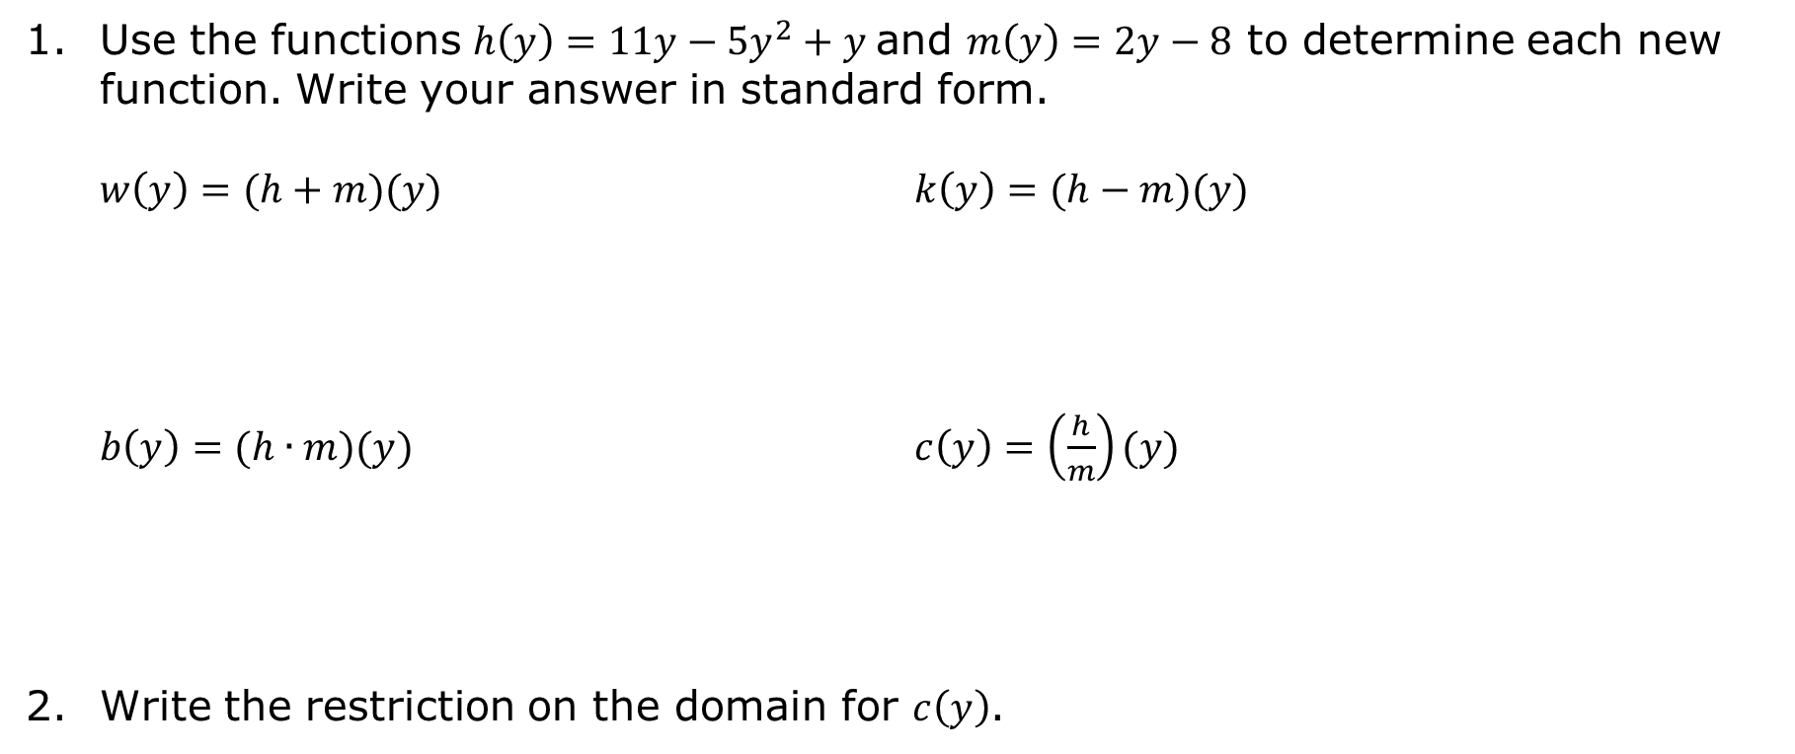
Use the functions $h\left(y\right)=11y−5y^{2}+y$and $m\left(y\right)=2y−8$ to determine each new function. Write your answer in standard form.
$w\left(y\right)=(h+m)(y)$ $k\left(y\right)=(h−m)(y)$
$b\left(y\right)=(h∙m)(y)$ $c\left(y\right)=\left(\frac{h}{m}\right)(y)$
Write the restriction on the domain for $c\left(y\right)$.
volume 2, pg. 301

Slide 24

Wrap-Up
volume 2, pg. 302

Slide 25
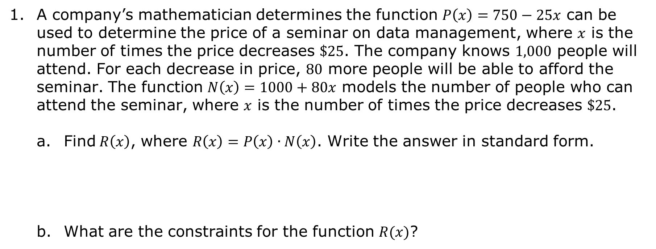
13.H2.5 Wrap-Up: Ticket Out the Door
A company’s mathematician determines the function $P\left(x\right)=750−25x$ can be used to determine the price of a seminar on data management, where $x$ is the number of times the price decreases $\$25$. The company knows $1,000$ people will attend. For each decrease in price, $80$ more people will be able to afford the seminar. The function $N\left(x\right)=1000+80x$ models the number of people who can attend the seminar, where $x$ is the number of times the price decreases $\$25$.
Find$R\left(x\right)$, where $R\left(x\right)=P\left(x\right)∙N\left(x\right)$. Write the answer in standard form.
What are the constraints for the function $R(x)$?
volume 2, pg. 302

